Slide 1
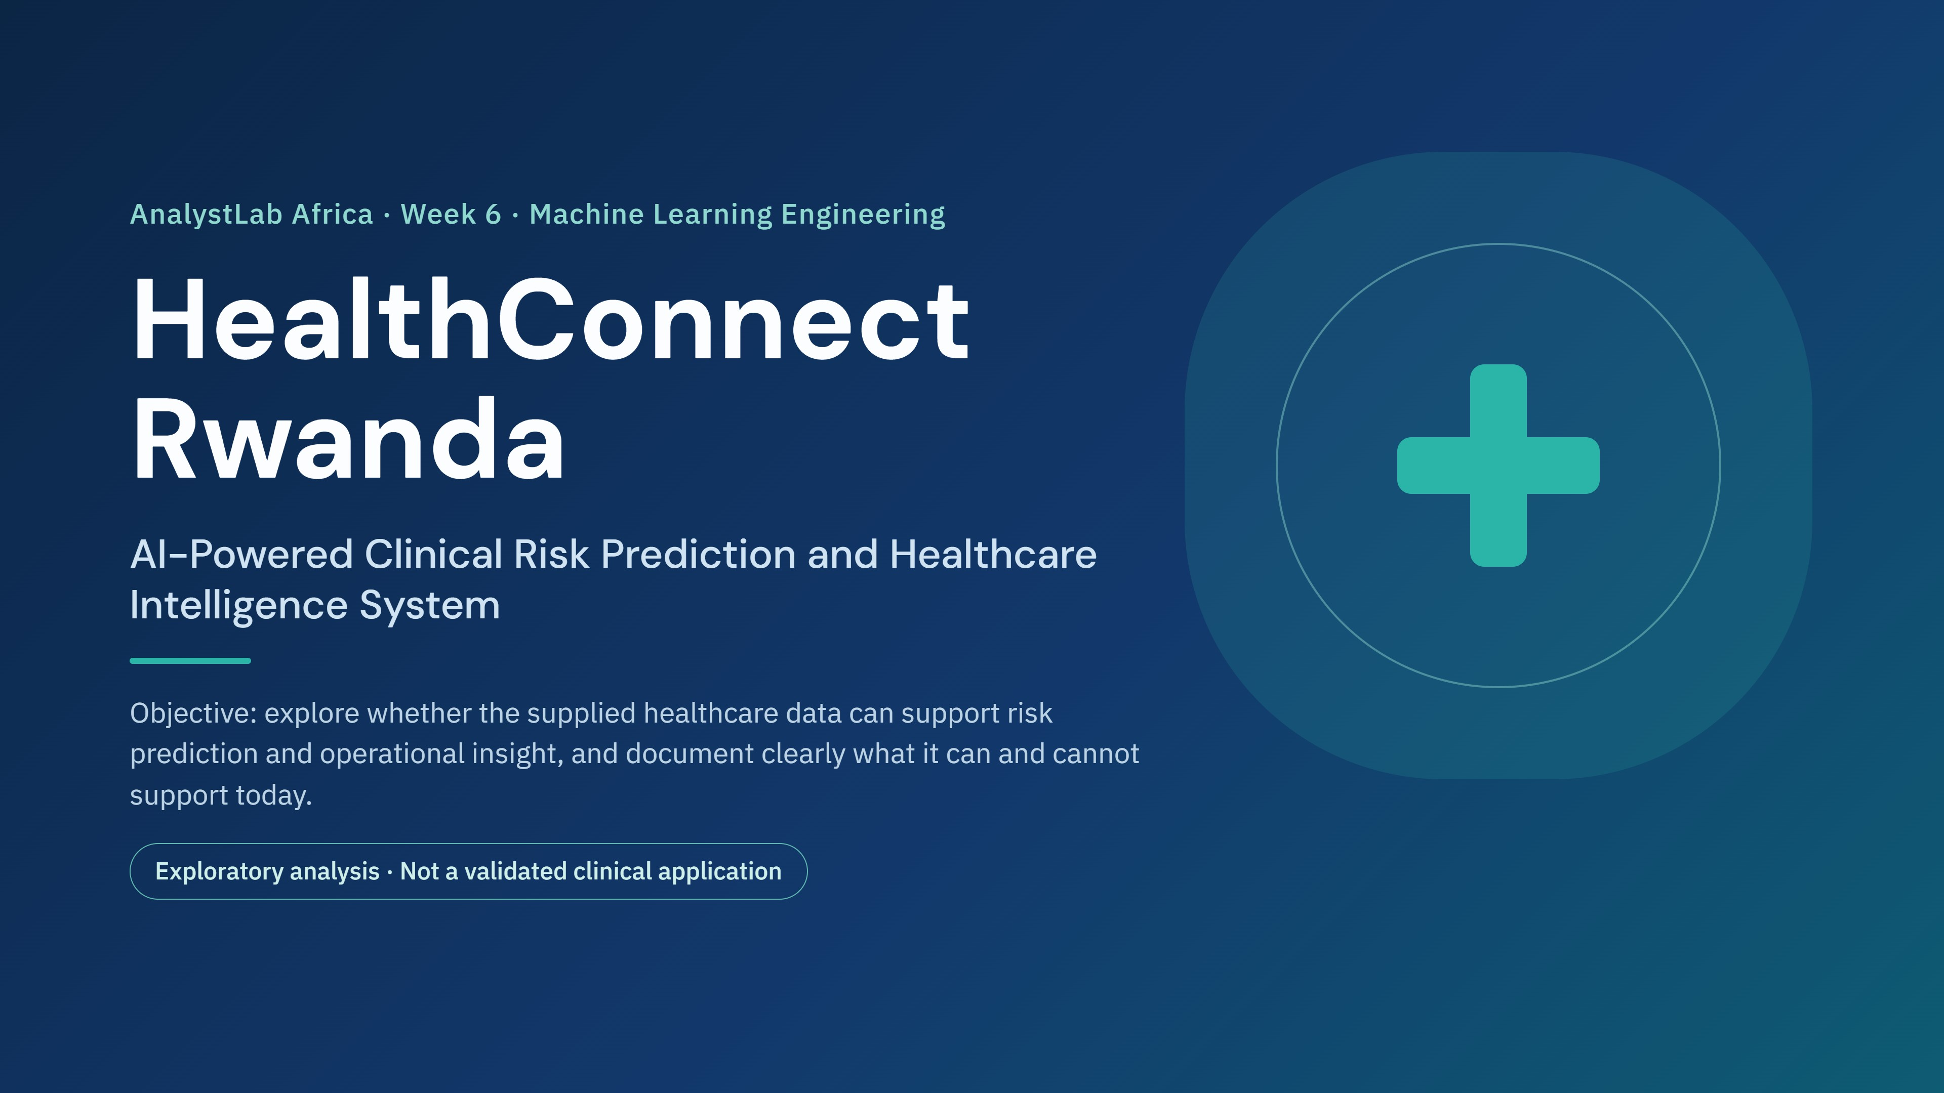
Notes:
Introduce HealthConnect Rwanda, the AnalystLab Africa Week 6 Machine Learning Engineering project. The purpose is to explore what the supplied healthcare data can support, and to be explicit about what it cannot. Everything in this deck is exploratory analysis, not a validated clinical application.

Slide 2
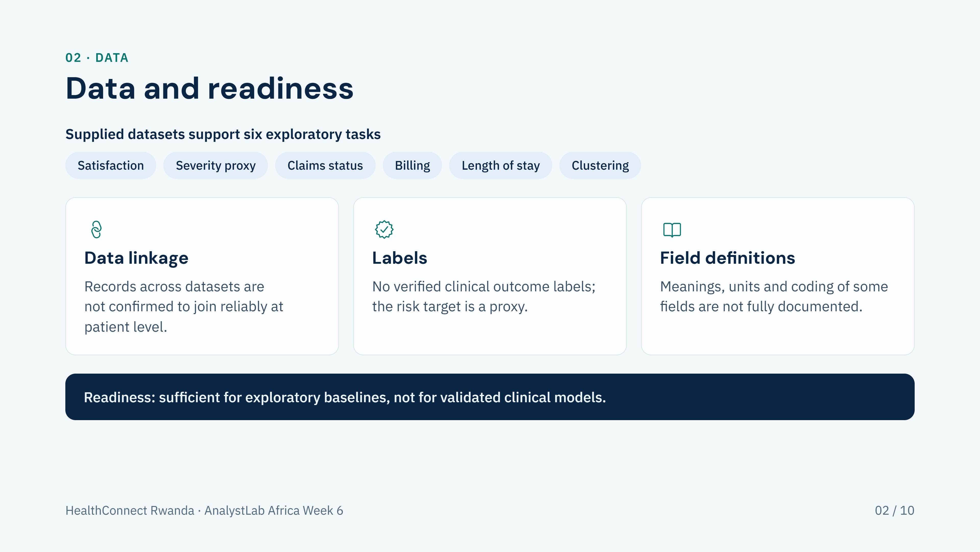
Notes:
The supplied healthcare datasets were enough to build exploratory baselines for satisfaction, a severity-based risk proxy, claims status, billing and length of stay, plus clustering. Three limitations shape everything that follows: linkage across datasets is not confirmed, verified clinical labels are missing, and some field definitions are not fully documented.

Slide 3
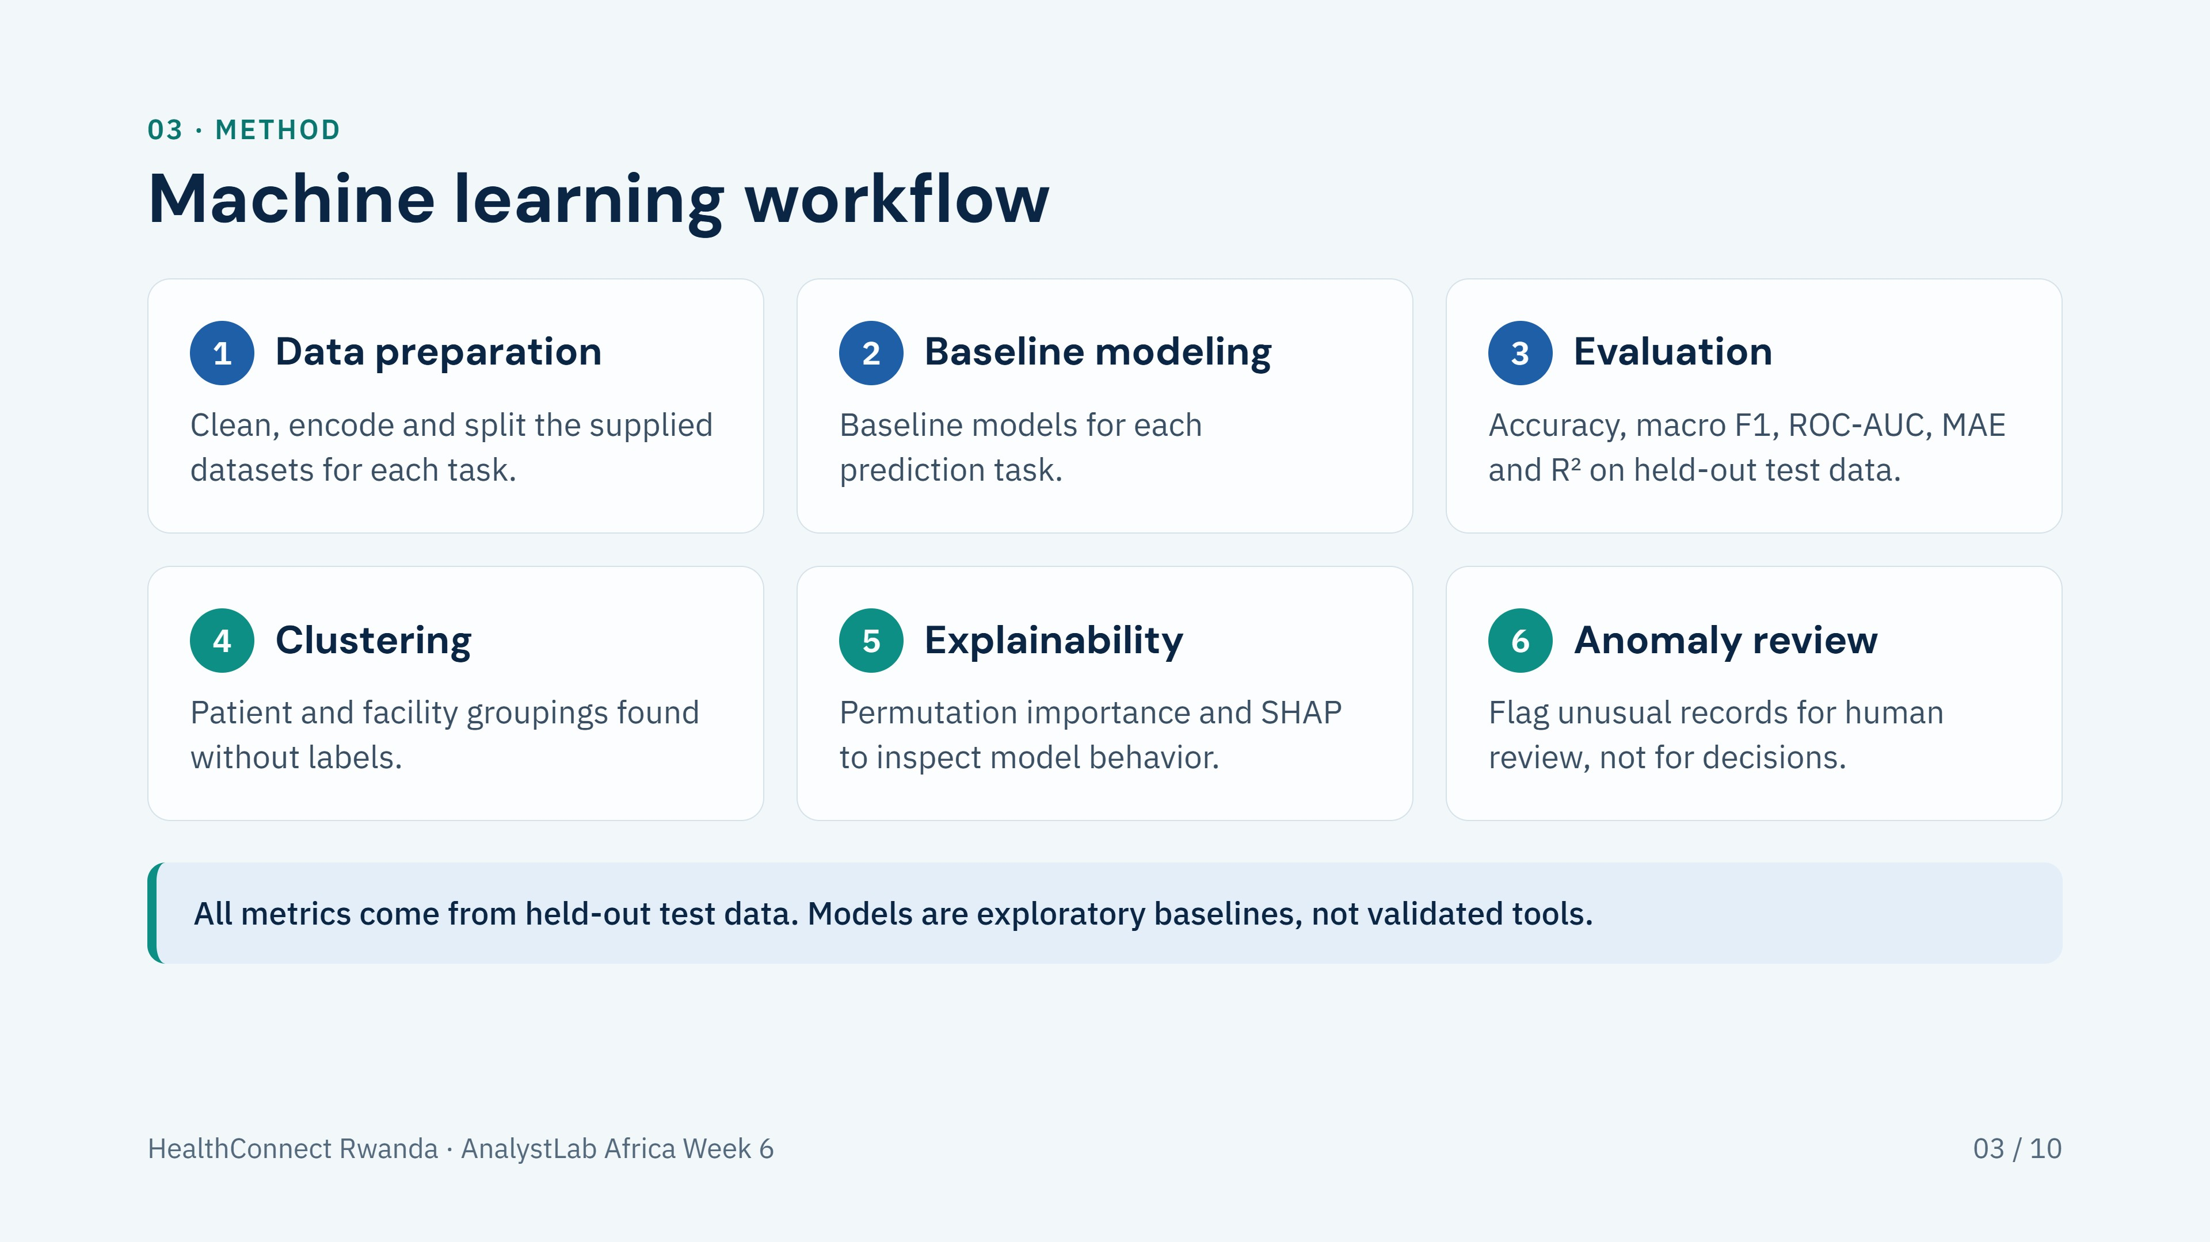
Notes:
Six steps: data preparation, baseline modeling, evaluation, clustering, explainability and anomaly review. Blue steps are supervised modeling; teal steps are descriptive and interpretive. Metrics are on held-out test data, and all models are exploratory baselines.

Slide 4
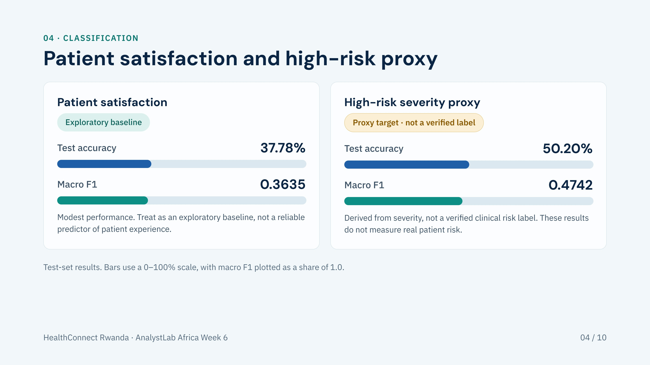
Notes:
Patient satisfaction: test accuracy 37.78%, macro F1 0.3635. High-risk severity proxy: test accuracy 50.20%, macro F1 0.4742. The risk target is a proxy built from severity, not a verified clinical label, so these numbers say nothing about real clinical risk prediction. Both are exploratory baselines.

Slide 5
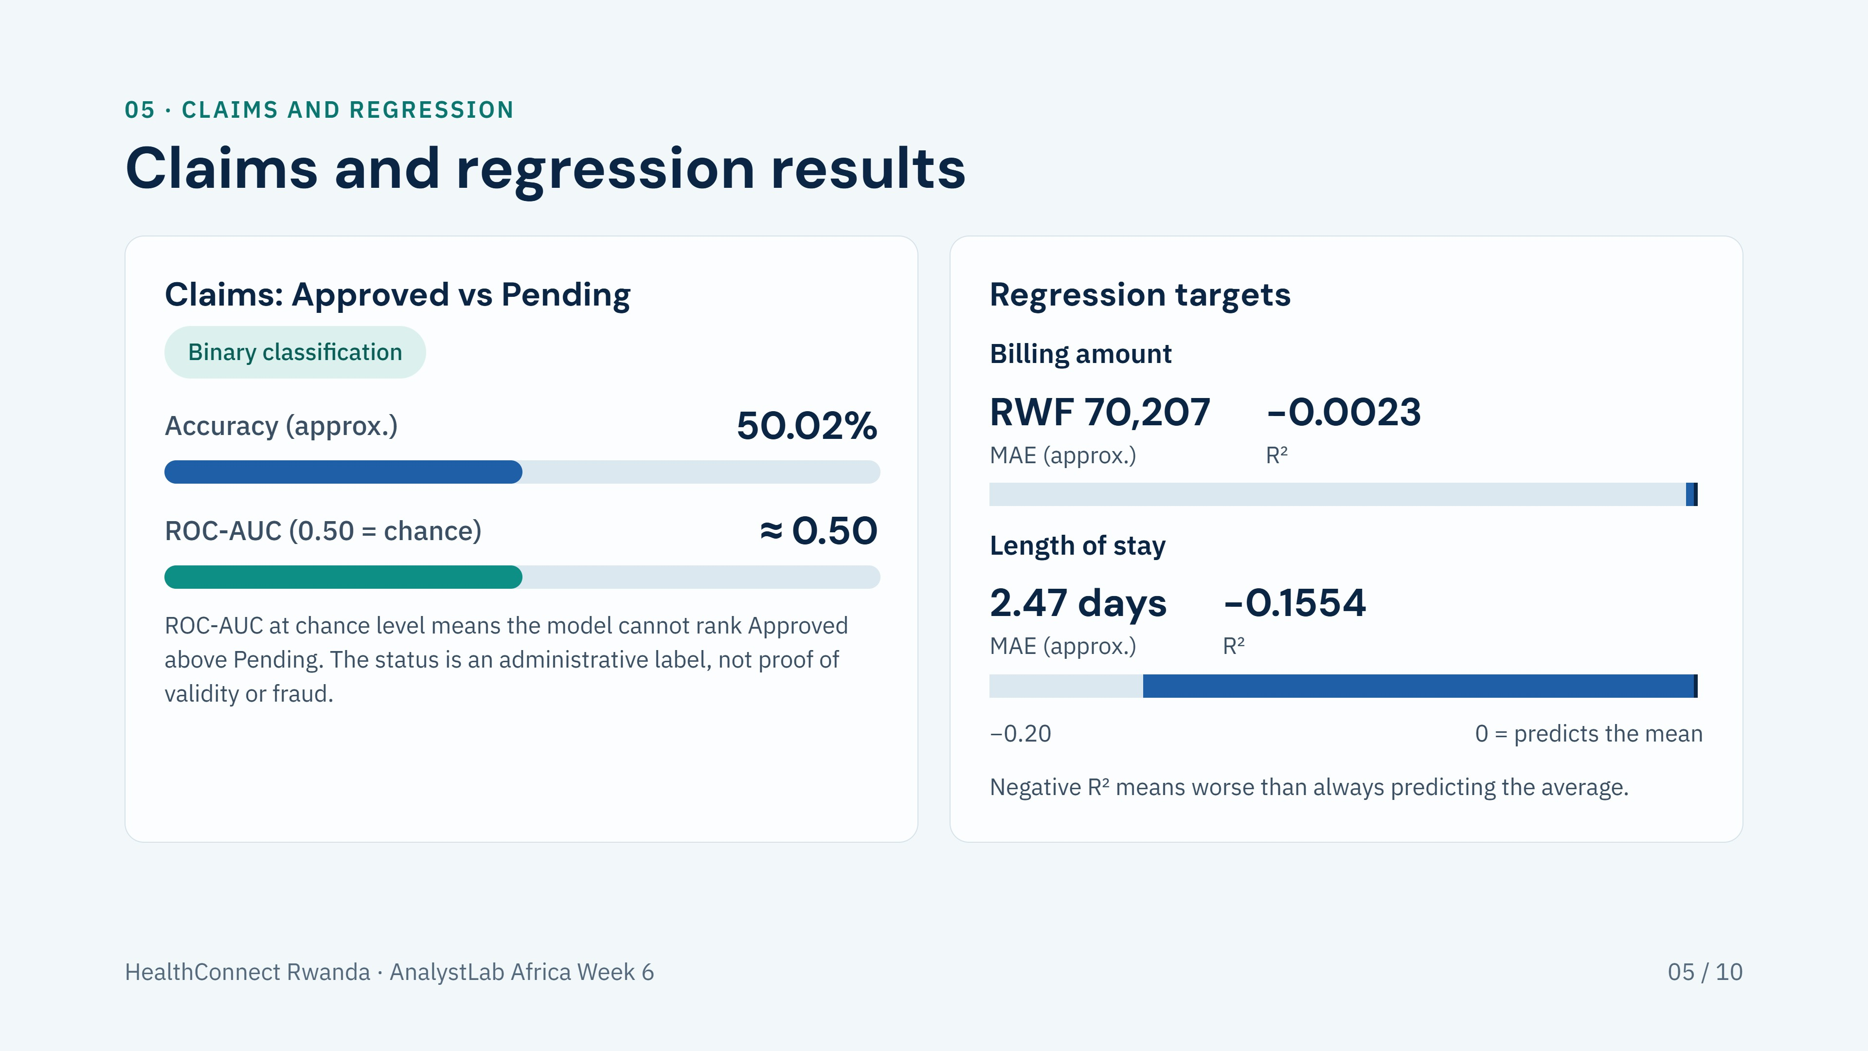
Notes:
Claims Approved vs Pending: accuracy approximately 50.02% and ROC-AUC approximately 0.50, which is chance-level ranking. Billing: MAE approximately RWF 70,207, R² of −0.0023. Length of stay: MAE approximately 2.47 days, R² of −0.1554. An R² at or below zero means the model does no better than predicting the average. None of these models is suitable for insurance, billing or clinical decisions.

Slide 6
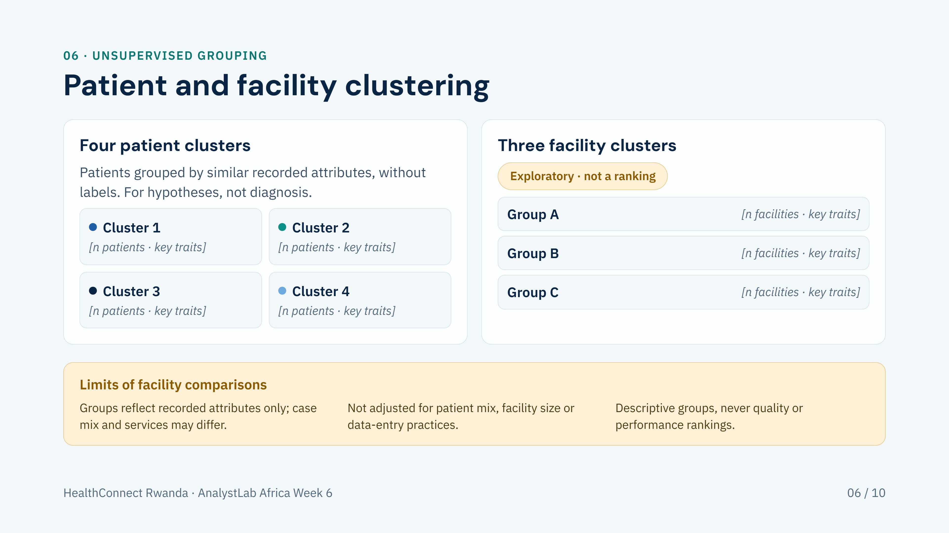
Notes:
Four patient clusters and three exploratory facility clusters were found without labels. Fill in the bracketed placeholders with cluster sizes and defining traits from the clustering notebook. Patient clusters are for generating hypotheses, not for diagnosis or risk tiers. Facility clusters are descriptive groupings only: they are not adjusted for patient mix or size, and must not be read as a performance or quality ranking.

Slide 7
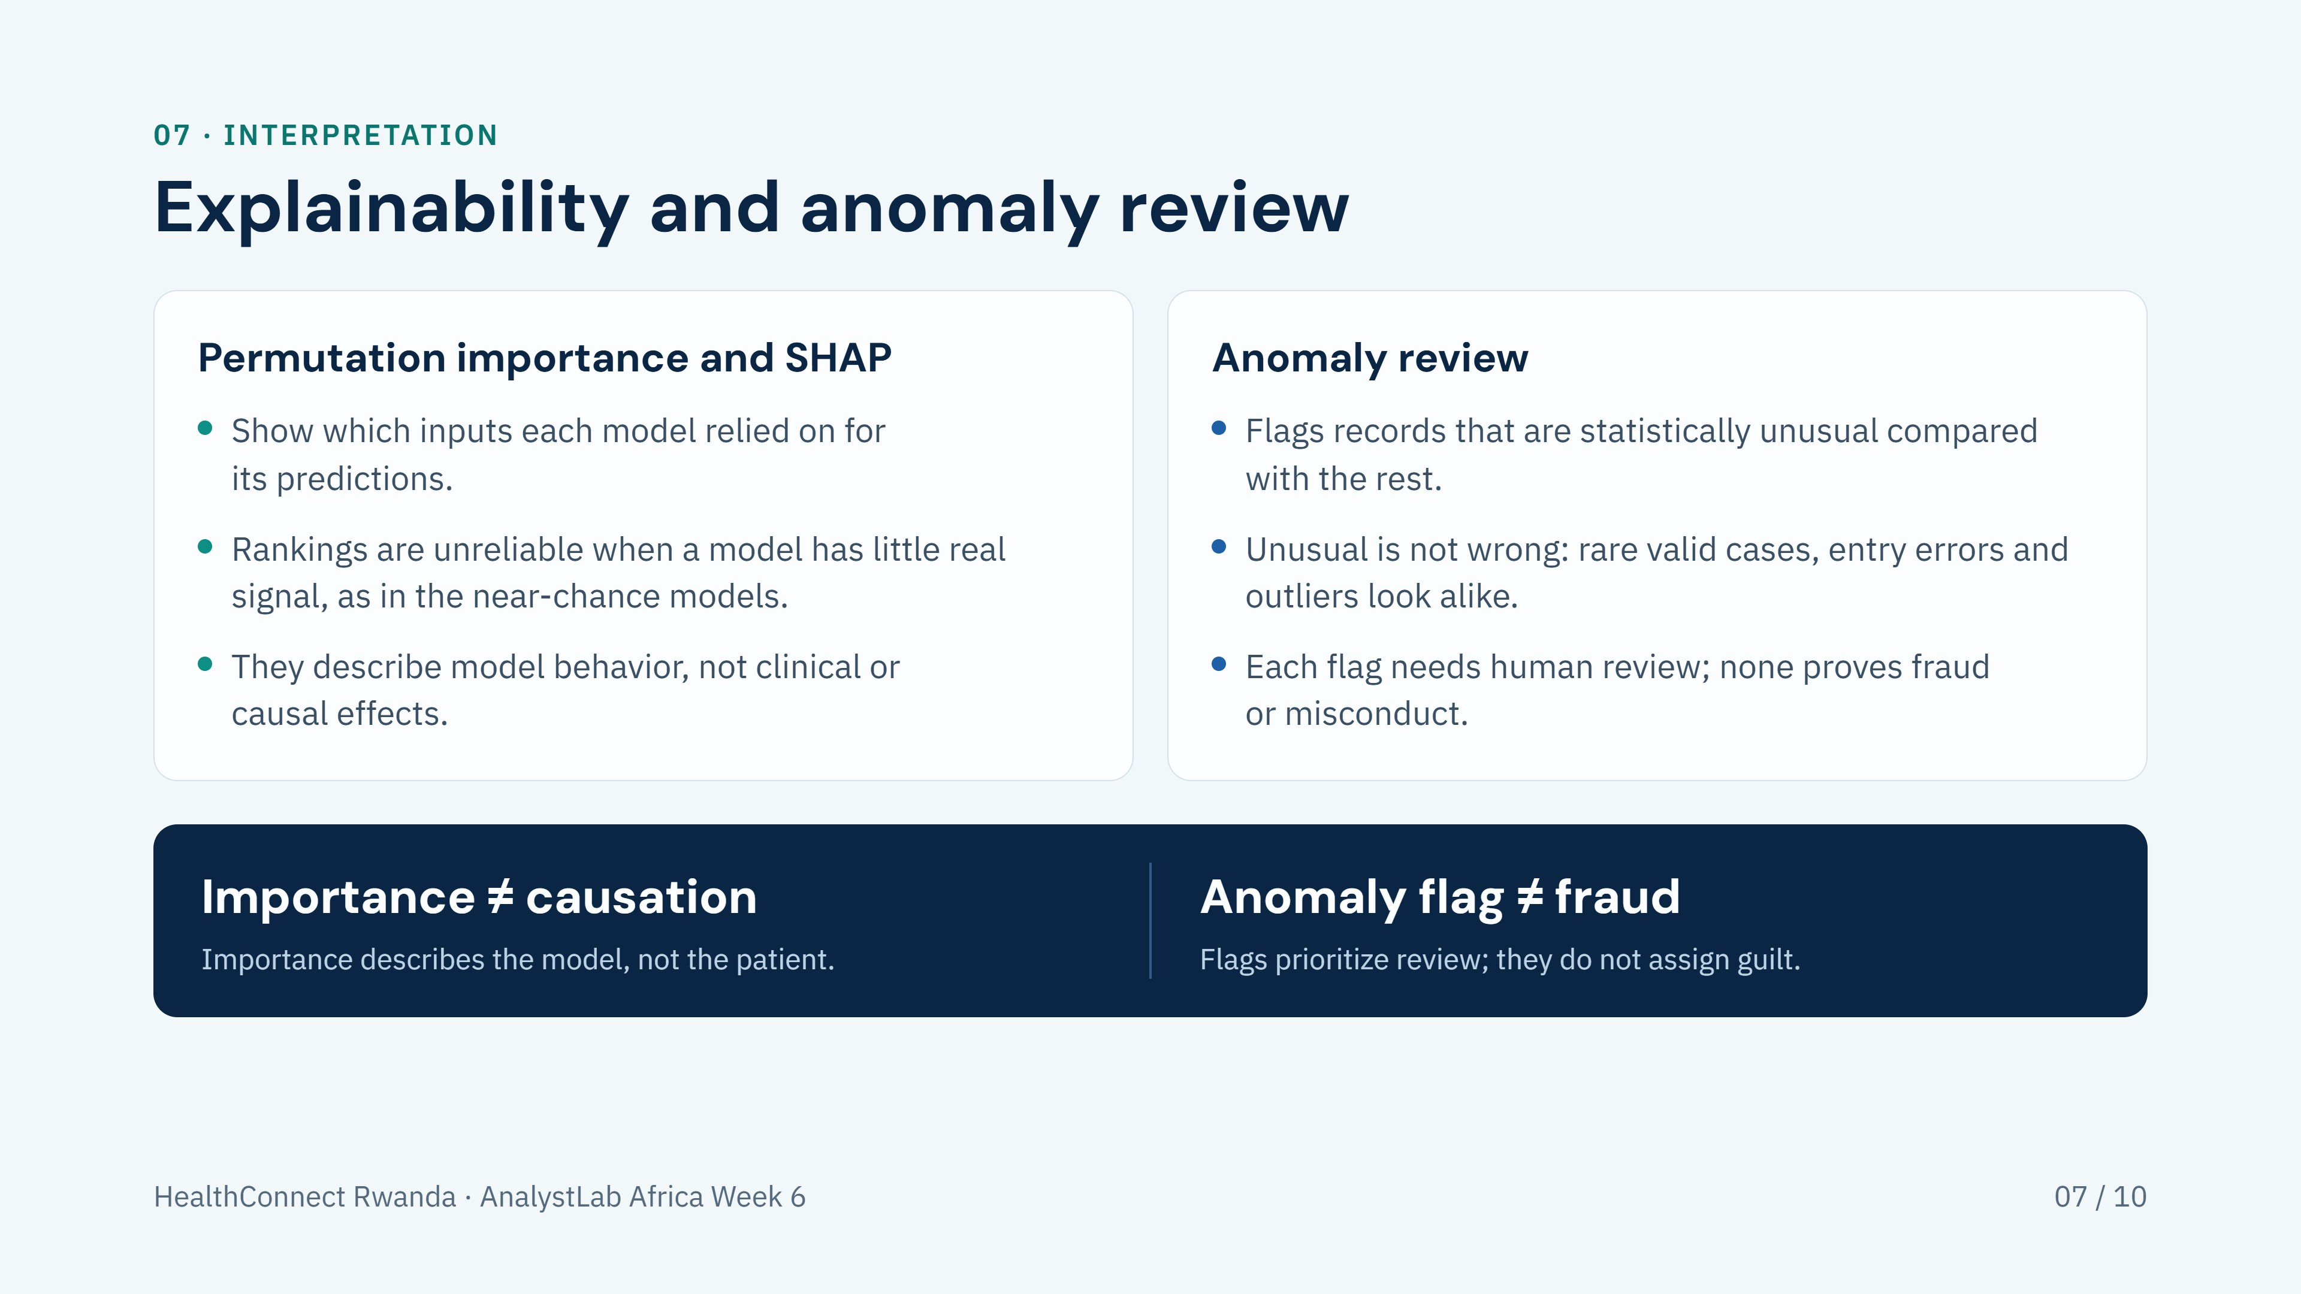
Notes:
Permutation importance and SHAP were used to inspect what each model relied on. Because several models show near-chance performance, their importance rankings should not be over-read. Neither method establishes causation. The anomaly review flags statistically unusual records only; a flag is a prompt for human review and is never evidence of fraud.

Slide 8
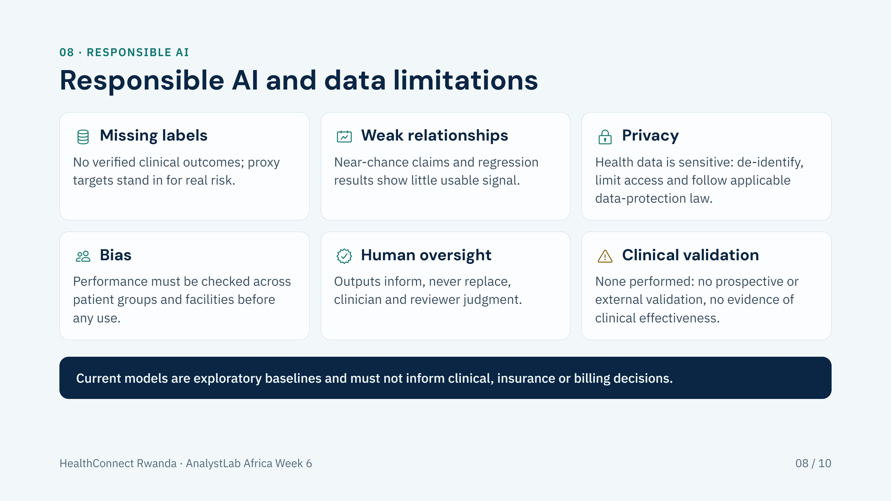
Notes:
Six limits to state plainly: verified labels are missing, relationships in the data are weak, health data is sensitive and needs privacy protection, bias across patient groups and facilities has not been assessed, outputs need human oversight, and there has been no clinical validation. The models are exploratory baselines and are not suitable for clinical, insurance or billing decisions.

Slide 9
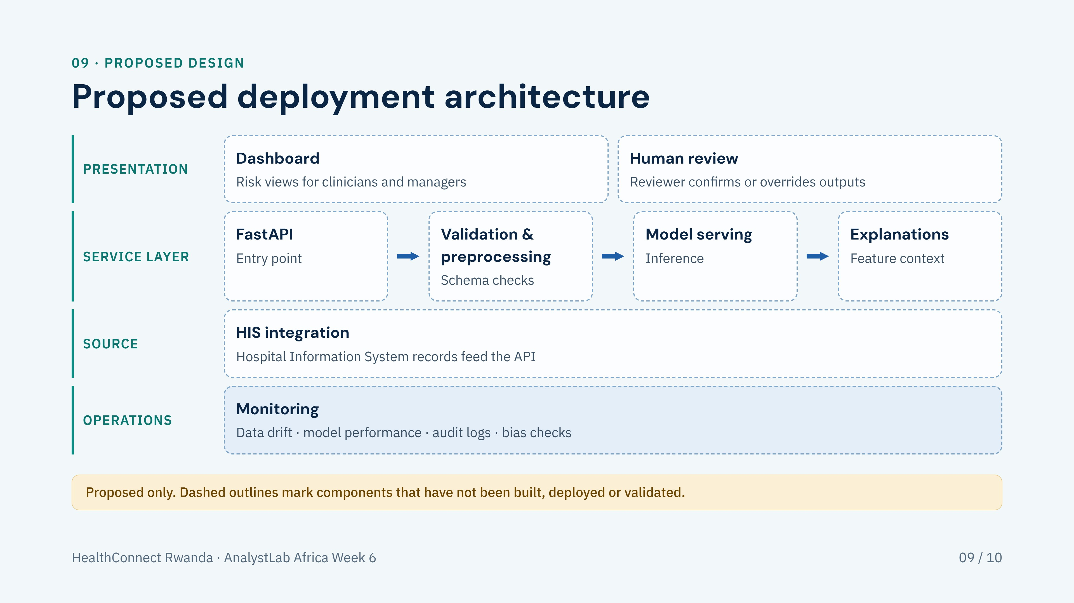
Notes:
This is a proposed design, not a deployed system. Records would flow from the Hospital Information System through a FastAPI service, then validation and preprocessing, model serving and explanations, into a dashboard and a human review step. Monitoring would cover data drift, model performance, audit logs and bias checks. Nothing shown here has been built, deployed or validated, and no current model is suitable for this use.

Slide 10
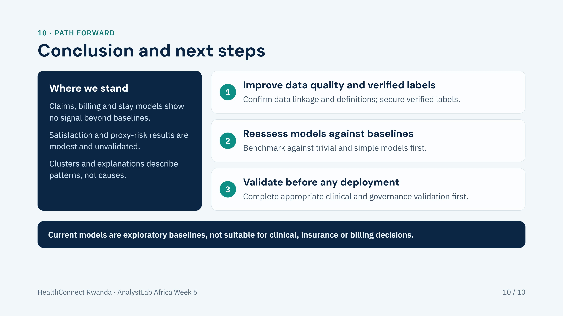
Notes:
Close by restating where things stand: the claims, billing and length-of-stay models show no signal beyond trivial baselines, and the satisfaction and proxy-risk results are modest and unvalidated. Next steps are to improve data quality and obtain verified labels, reassess models against baselines, and complete appropriate validation before any deployment. Until then, these are exploratory baselines only.

